Slide 1

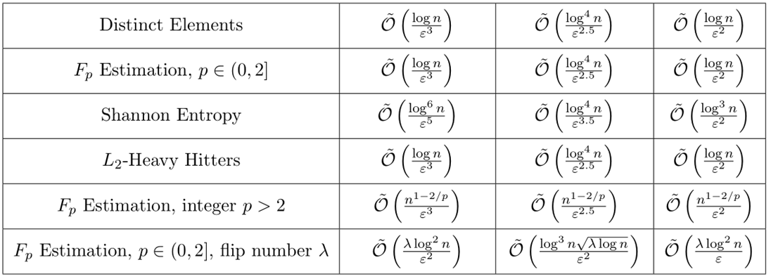
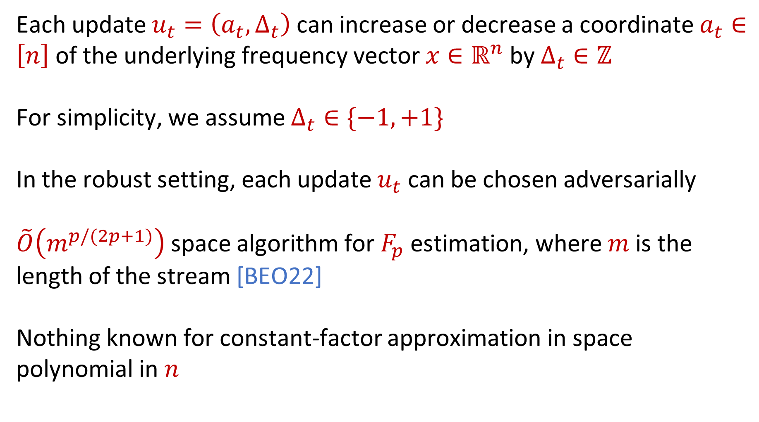
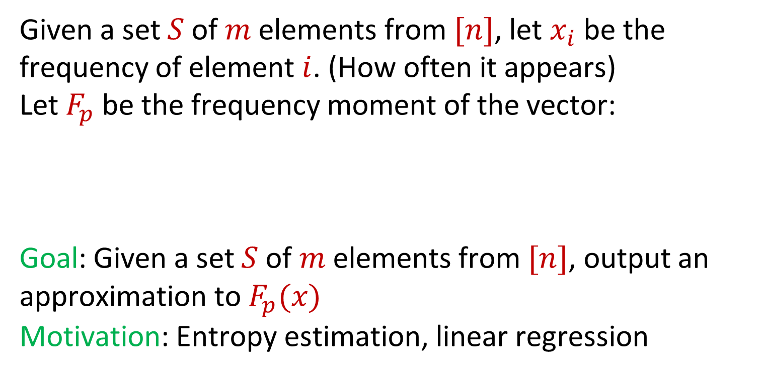
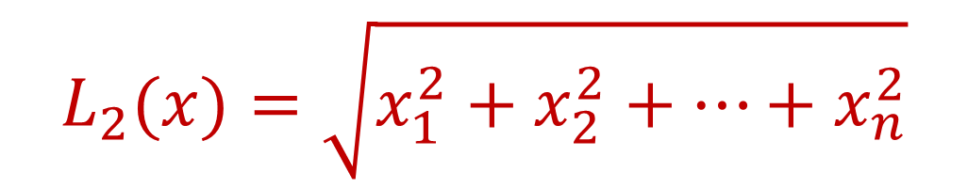
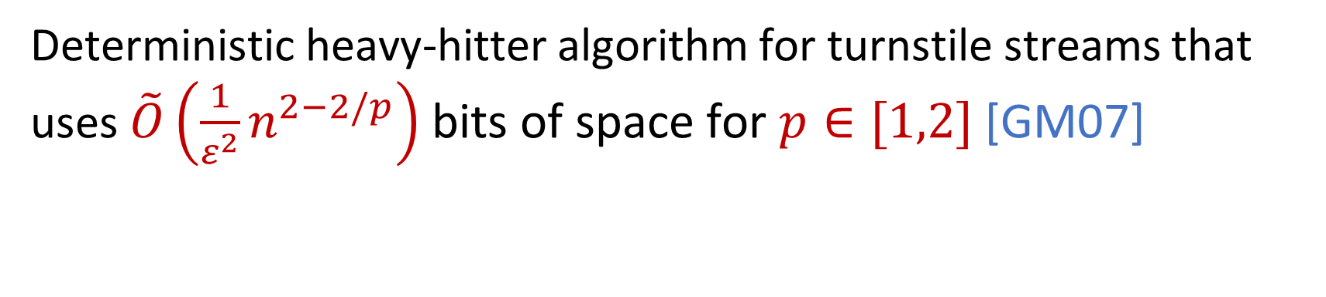
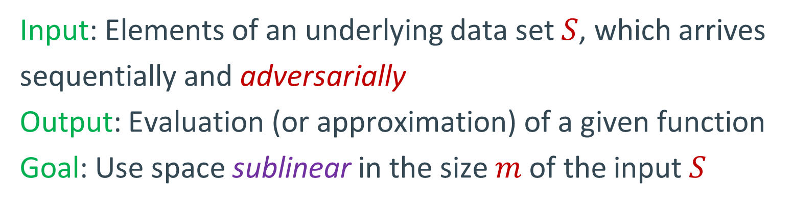
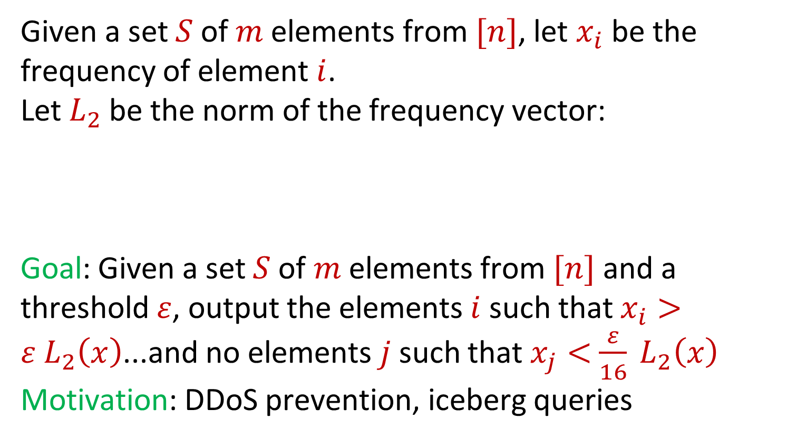
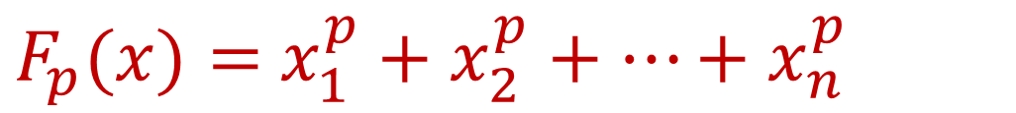
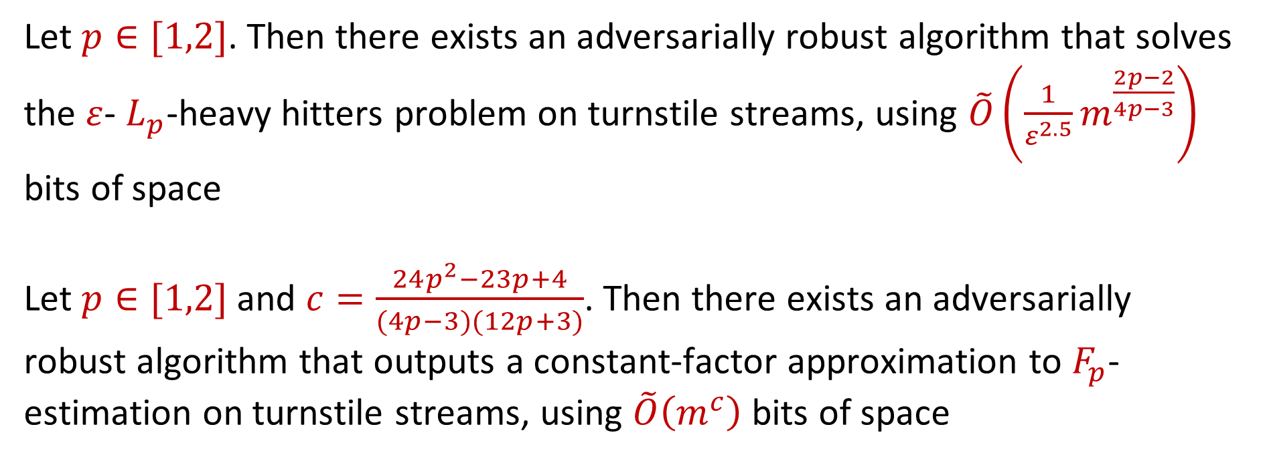
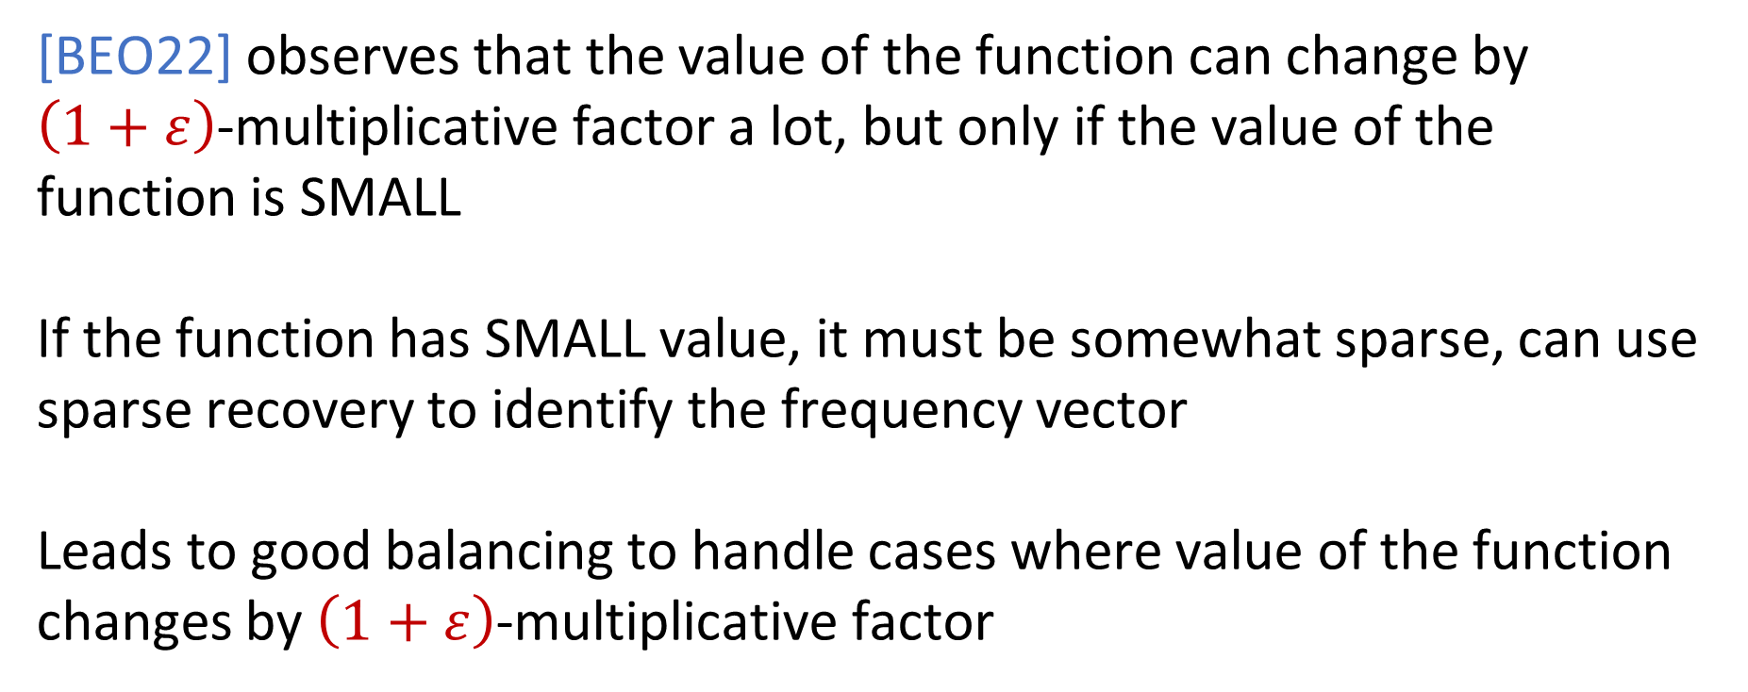
Adversarially Robust Dense-Sparse Tradeoffs via Heavy-Hitters
David P. Woodruff, Carnegie Mellon University and Google Research
Samson Zhou, Texas A&M University
Model
Insertion-Deletion Streams
Techniques
Input: Elements of an underlying data set $S$, which arrives sequentially and adversarially
Output: Evaluation (or approximation) of a given function
Goal: Use space sublinear in the size $m$of the input $S$
Each update $u_{t}=\left(a_{t},Δ_{t}\right)$ can increase or decrease a coordinate $a_{t}∈\left[n\right]$ of the underlying frequency vector $x∈ℝ^{n}$ by $Δ_{t}∈ℤ$
For simplicity, we assume $Δ_{t}∈\{−1,+1\}$
In the robust setting, each update $u_{t}$ can be chosen adversarially
$\tilde{O}\left(m^{p/(2p+1)}\right)$ space algorithm for $F_{p}$estimation, where $m$is the length of the stream [BEO22]
Nothing known for constant-factor approximation in space polynomial in $n$
Deterministic heavy-hitter algorithm for turnstile streams that uses $\tilde{O}\left(\frac{1}{ε^{2}}n^{2−2/p}\right)$ bits of space for $p∈[1,2]$ [GM07]
Frequency Moments
Given a set $S$ of $m$ elements from $[n]$, let $x_{i}$ be the frequency of element $i$. (How often it appears)
Let $F_{p}$ be the frequency moment of the vector:
Goal: Given a set $S$ of $m$ elements from $[n]$, output an approximation to $F_{p}(x)$
Motivation: Entropy estimation, linear regression
$F_{p}(x)=$ $x_{1}^{p}+x_{2}^{p}+…+x_{n}^{p}$
Dense-Sparse Tradeoffs
[BEO22] observes that the value of the function can change by $\left(1+ε\right)$-multiplicative factor a lot, but only if the value of the function is SMALL
If the function has SMALL value, it must be somewhat sparse, can use sparse recovery to identify the frequency vector
Leads to good balancing to handle cases where value of the function changes by $\left(1+ε\right)$-multiplicative factor
Heavy-Hitters
Given a set $S$ of $m$ elements from $[n]$, let $x_{i}$ be the frequency of element $i$.
Let $L_{2}$ be the norm of the frequency vector:
Goal: Given a set $S$ of $m$ elements from $[n]$ and a threshold $ε$, output the elements $i$ such that $x_{i}>$ $ε L_{2}\left(x\right)$...and no elements $j$ such that $x_{j}<$ $\frac{ε}{16} L_{2}\left(x\right)$
Motivation: DDoS prevention, iceberg queries
$$L_{2}(x)=\sqrt{x_{1}^{2}+x_{2}^{2}+…+x_{n}^{2}}$$
Our Results
Let $p∈[1,2]$. Then there exists an adversarially robust algorithm that solves the $ε$- $L_{p}$-heavy hitters problem on turnstile streams, using $\tilde{O}\left(\frac{1}{ε^{2.5}}m^{\frac{2p−2}{4p−3}}\right)$ bits of space
Let $p∈[1,2]$ and $c=\frac{24p^{2}−23p+4}{(4p−3)(12p+3)}$. Then there exists an adversarially robust algorithm that outputs a constant-factor approximation to $F_{p}$-estimation on turnstile streams, using $\tilde{O}\left(m^{c}\right)$ bits of space
Insertion-Only Streams
[WZ21]
[BJWY20]
[HKM+20]

